Slide 1
CS5351 Software Engineering
2025/26 Semester A
Quiz 2

Slide 2
Summary
Bins | Num
100 | 3
85 | 3
80 | 10
75 | 8
70 | 26
65 | 29
60 | 60
47 | 27
35 | 23
Mean | Median | Max | Min
56 | 56 | 88 | 7

Slide 3
TAs
Inquiries and reviews regarding quiz scores will only be accepted within one week (Until Dec 1). No late request will be considered.
Questions | TA | Email
Q1 | Yue LI | yueli345-c@my.cityu.edu.hk
Q2, Q3 | Qilin ZHOU | qlzhou4-c@my.cityu.edu.hk
Q4 | Zhuo WANG | zwang2346-c@my.cityu.edu.hk
Q5 | Xiangrui ZENG | xiazeng9-c@my.cityu.edu.hk
Q6 | Xiaona LI | xiaonali3-c@my.cityu.edu.hk

Slide 4
Q1. Abstraction: Question
A queue is a First-In-First-Out (FIFO) abstract data type that supports the following operations:
empty: creates an empty queue.
enqueue(q, x): adds element x to the rear of queue q.
dequeue(q): removes the head element from queue q. If q is an empty queue, it returns the empty queue.
head(q): returns the element at the head position of queue q. If q is an empty queue, it returns ⊥.
  Hint: a queue adds an element to the tail, rather than the head, position.
isEmpty(q): returns true if queue q is empty, otherwise false.
Define queue in the functional style (abstract data type like what we did in the tutorial) by inter-relating its operations.

Slide 5
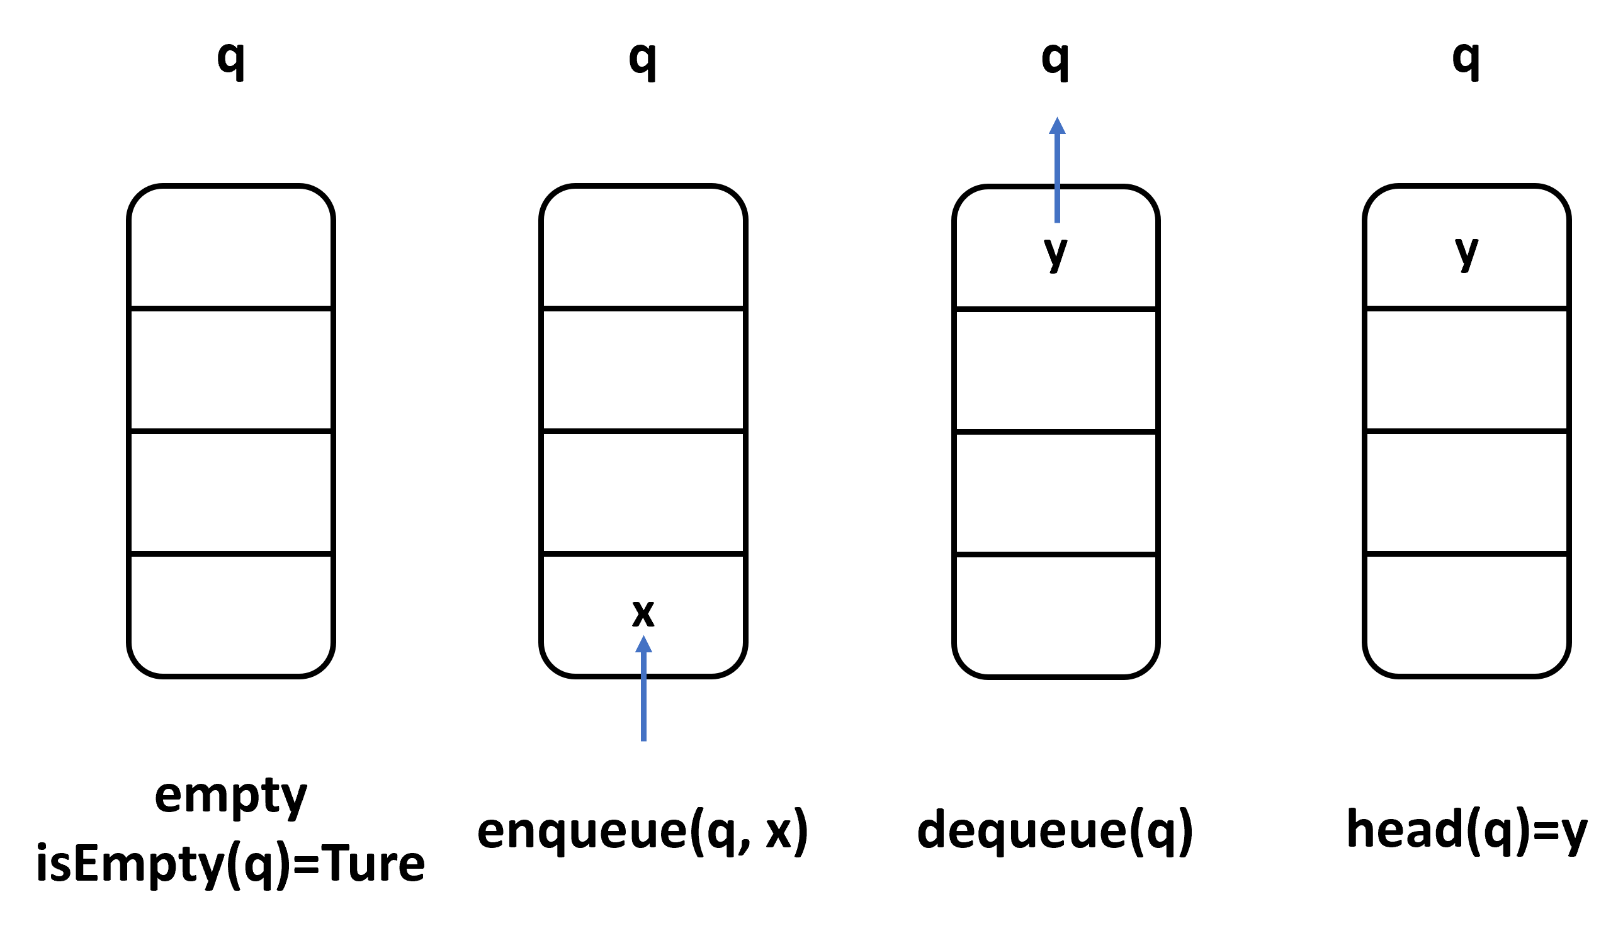
First-In-First-Out (FIFO) Queue

Slide 6
Q1. Abstraction: Marking scheme
Empty queue’s behavior
  isEmpty(empty) = true (2 marks)
  head(empty) = ⊥ (2 marks)
  dequeue(empty) = empty (2 marks)
Non-empty queue’s behavior
  isEmpty(enqueue(q, x)) = false (2 marks)
  head(enqueue(empty, x)) = x (2 marks)
  head(enqueue(q, x)) = head(q) if not isEmpty(q) (3 marks)
  dequeue(enqueue(empty, x)) = empty (2 marks)
  dequeue(enqueue(q, x)) = enqueue(dequeue(q), x) if not isEmpty(q) (3 marks)

Slide 7
Q2. Design Principle: Question
Consider the following anticipated change:
• In the future, the program may be required to count other categories of letters, such as digits and punctuation.
Explain why the given program P violates the Open-Closed Principle (OCP)?

Slide 8
Q2. Design Principle: Marking scheme
Marking scheme:
+ Locate that the problem in the function Analyzer::analyze(char c) (5 marks)
+ Mention that it is ``hardcoded logic’’ (5 marks)
+ Further reasonable explanation about the anticipated change and OCP (4 marks)
++ Answering the specific code segment violating the principle and analysing it is also good.

Slide 9
Q2. Design Principle: Reference Answer
Hardcoded Logic in Analyzer::analyze(char c)
The logic for identifying uppercase vowels, lowercase consonants, and whitespace characters is explicitly hardcoded in the method body. If adding a new category of letter for counting, this method is required to be modified (i.e., not closed for modification).
  A general answer like stating that the problem lies in the class Analyzer is inaccurate, as the program P almost entirely consists of this class.

Slide 10
Q3. Coupling and Cohesion: Question & Marking scheme
What is the type of coupling between the function void analyze(char c) and bool isLower(char c) in program P?
  There are several types of coupling we learned: Content, Common, External, Control, Stamp, Data.
Marking Scheme:
  Data coupling (4 marks)
  Why data coupling (2 marks)
  Notes：Content (directly use a part of code), Common (global variable), External (interface protocol, file), Control (control flow, workflow pipeline), Stamp (a part of a data structure), Data (the whole data structure), see Page 28 in cs5351-code-with-quality-v7

Slide 11
Q3. Coupling and Cohesion: Reference Answer
bool isLower(char c) {
return c >= 'a' && c <= 'z';}
void analyze(char c) {
if (c == 'A'||c == 'E'||c == 'I'||c == 'O'||c == 'U') {
upperVowels++;
}
else if (isLower(c) && !(c == 'a'|| c == 'e' ||
c == 'i' || c == 'o' || c == 'u')) {
lowerConsonants++;
getchar(); // BUG
}
else if (isSpace(c)) {
whitespaces++;
}
}
Reference Answer:
Data Coupling.
analyze() and isLower() communicate through a data item (char c).
Not Control coupling: A common case of control coupling has control information, something usually the caller (analyze) passes to the callee (isLower) / or used globally (e.g. a global variable) that directly determines which branch of logic will execute. Here is not the case.

Slide 12
Q4. Delta Debugging: Question
Program P contains a bug, as highlighted, which is exposed by the following test case:
  Input: CS5351 SW Engineering 2025/2026
  Actual Output: 1 uppercase vowel, 4 lowercase consonants, 3 whitespace characters
  Expected Output: 1 uppercase vowel, 6 lowercase consonants, 3 whitespace characters
Your Task: Perform Delta Debugging to reduce the input while preserving the failure exactly the same as shown in the actual output above (i.e., the text in the above actual output that shows the failure should be kept in the output of your reduced input). Your answer must show the entire sequence of inputs you derived when applying Delta Debugging.

Slide 13
Q4. Delta Debugging: Marking scheme&
Reference Answer
Marking scheme [14 marks in total]:
  Remove the prefix (4 marks)
  Remove the suffix (4 marks)
  Get the final the sequence “ngineering” (6 marks)
Reference answer:
  CS5351 SW Engineering 2025/2026
  → Engineering 2025/2026
  → Engineering
  → ngineering (can’t future trim off the string)
  Actual Output: 0 uppercase vowels, 4 lowercase consonants, 0 whitespace characters
  Expected Output: 0 uppercase vowels, 6 lowercase consonants, 0 whitespace characters
Note: preserve the failure exactly as shown in the expected output above

Slide 14
Q5.a Metamorphic Relation: Questions
(14 marks). Is MR1 strong enough to detect the failure of program P due to the highlighted bug? Explain your answer with the help of the test case in Question 4.
Metamorphic relation MR1:
Let x be a text string, which is arbitrarily split into two consecutive substrings: y and z. The total number of uppercase vowels, lowercase consonants, and whitespace characters in y and z reported by P should be equal to the number of uppercase vowels, lowercase consonants, and whitespace characters in x reported by P. Strong enough for MR1?

Slide 15
Q5.a Metamorphic Relation: Answers
Yes, MR1 is strong enough. Using the following split of x into y and z, the numbers of lowercase consonants reported by P on x, y, and z will be 4, 1, and 4, respectively. Since 4 is not equal to 1+4, so, a violation of MR1 is detected.
e.g.,
x = CS5351 SW Engineering 2025/2026
y = CS5351 SW En
z = gineering 2025/2026
Explanation: We say MR1 is strong enough, since the 'additivity' is a necessary consequence of string statistics. If the program is correct, 'additivity' will be satisfied naturally, on the contrast, the bug in P will
Break this property.
We don’t expect MR1 can detect the bug in a single trail, but with sufficient tests, we can find the bug: only when split a string between two lowercase consonant letters will lead to the 'additivity' not being satisfied.

Slide 16
Q5.b Metamorphic Relation: Marking scheme
+ Answer ``Yes, MR1 is strong enough.’’ (6 marks)
+ Correctly use the test case in Question 4 with MR1 (4 marks)
+ Show how the test case finds the failure (4 marks)

Slide 17
Q5.b Metamorphic Relation: Questions
(14 marks). What’s wrong with MR2 if we use it as a metamorphic relation for testing program P? What is the consequence if we use it to test P? Explain your answer.
MR2: Let x be an arbitrary text string. y is produced by converting all characters in x from uppercase to lowercase and vice versa, followed by reversing the string. Program P should report different numbers of uppercase vowels and lowercase consonants between x and y.
AbCd->DcBa

Slide 18
Q5.b Metamorphic Relation: Answers
MR2 is not a metamorphic relation.
Metamorphic relations should be a necessary (or expected) property of the expected and correct behavior of a program.
For MR2, there is no logical relation that flipping lowercase and uppercase letters must give different numbers of uppercase vowels and lowercase consonants.
If using MR2 to test P, MR2 will report a lot of false positive pairs of test cases.

Slide 19
Q5.b Metamorphic Relation: Answers
If using MR2 to test P, MR2 will report a lot of false positive pairs of test cases.
Empty string
x = " " (single space)
  UV(x) = 0, LC(x) = 0
y = " "
UV(y) = 0, LC(y) = 0
No letters
x = "12345!?/"
  UV(x) = 0, LC(x) = 0
y = "/!?54321"
UV(y) = 0, LC(y) = 0
Special case
x = "AaBbCc"
  UV(x) = 1, LC(x) = 2
y = "CcBcAa"
UV(y) = 1, LC(y) = 2
Only lowercase vowels
x = "aeiou"
  UV(x) = 0, LC(x) = 0
y = "UOIEA"
UV(y) = 5, LC(y) = 0
Only uppercase consonants
x = "BCDFG"
  UV(x) = 0, LC(x) = 0
y = "gfdcb"
UV(y) = 0, LC(y) = 5
In these cases, the program is working as expected, but MR2 will incorrectly flag them as failures because it assumes the counts should always be different after performing the case swap and reversal operation. This is why MR2 is not a valid metamorphic relation—it doesn’t reflect an inherent property of correct behavior.

Slide 20
Q5.b Metamorphic Relation: Marking scheme
Show what’s wrong with MR2 if we use it as a metamorphic relation (8 marks in total):
+ Metamorphic relations should be a necessary (or expected) property of the expected and correct behavior of a program. (4 marks)
+ MR2 has no logical relation. (4 marks)
Show the consequence if we use it to test P :
+ a lot of false positive pairs of test cases. (6 marks)

Slide 21
Q6. Fuzzing by AFL: Question
You are given the same fuzzing as in the tutorial exercise on fuzzing in Week 9, where the details are recapped below. However, it has a new set of deterministic operators: O3 and O4, instead of the original O1 and O2.
  Mutation O3(x) = {return (x / 2) +1}
  Mutation O4(x) = {return (int) (x*1.1)}
  Note that the division is an integer arithmetic operator. (e.g., Computing 13 / 2 produces 6)

Slide 22
Q6. Fuzzing by AFL: Marking scheme
Marking Scheme:
  Correct calculation of mutations. (4 marks)
  Correct branch coverage. (4 marks)
  Accurate identification of new coverage. (4 marks)
  Correct queue evolution sequence. (4 marks)
Clearly identifies that x=3 causes the program g(x) to crash, and that the fuzzing algorithm terminates at this point. ( 4 marks)

Slide 23
Q6. AFL Concept (Super Short Version)
AFL maintains a queue of inputs.
For each input x:
Apply mutation O3, then O4.
Run g(x) and see what branches are executed.
If coverage is new, add input to queue.
If g(x) crashes, fuzzing stops immediately

Slide 24
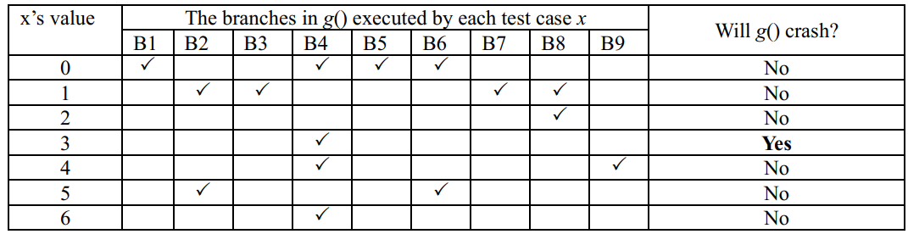
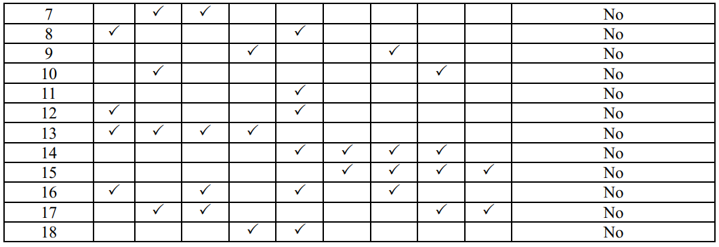
Q6. Fuzzing by AFL: Key Settings In Q6
Content​
  Initial seed queue: <13>
  Mutations:
  O3(x) = {return (x / 2) +1}
  O4(x) = {return (int) (x*1.1)}
  Branch coverage table
  determines whether coverage is new.
  Important:
  g(3) crashes, so once input becomes 3 → algorithm terminates.

Slide 25
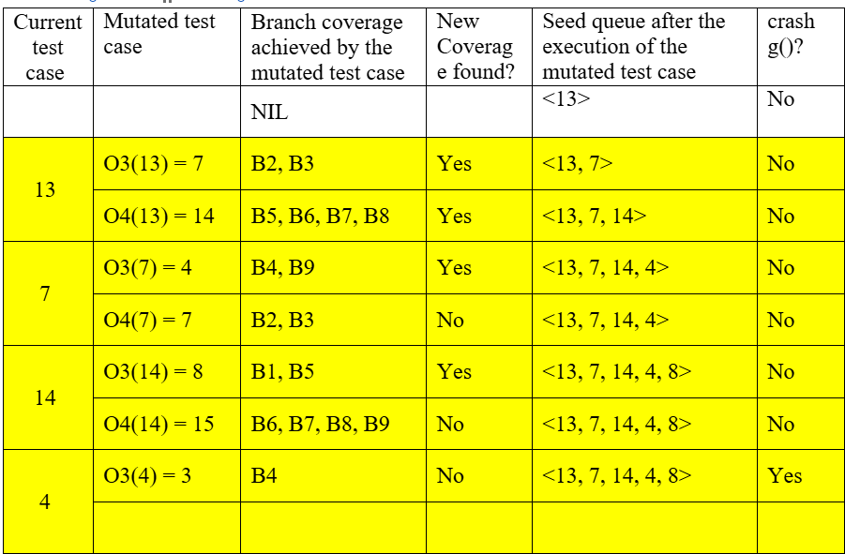
Q6. Fuzzing by AFL: Reference Answer

